Slide 1
Health Plans
Sept. 18 -Sept. 22, 2017
,

Slide 2
Learning Target: I will create a diagram illustrating the 10 life skills essential to healthy living.
Bell Ringer: What do you think of when you hear someone say “life skills”?
Ending Activity: Group diagram of all 10 life skills with discussion of what the first few mean.

Slide 3
Learning Target: I will create a diagram illustrating the 10 life skills essential to healthy living.
Bell Ringer: What does it mean to make good decisions?
Ending Activity: Group activity in making decisions on island activity.

Slide 4
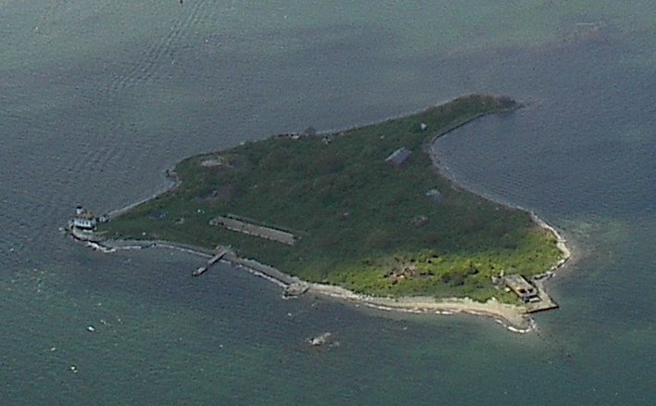

Slide 5
Learning Target: I will use advertisements to make decisions on important and smart purchases.
Bell Ringer: Describe an important decision you have had to make.
Ending Activity: Group activity on making smart purchases on a limited budget

